Slide 1
EVALUATE LOGISTIC REGRESSION MODEL

Slide 2
What is Confusion Matrix?
A confusion matrix is a performance measurement technique for Machine learning classification. It is a kind of table which helps you to the know the performance of the classification model on a set of test data for that the true values are known.
The main idea behind this evaluation metric is to understand how good our model is when dealing with false-positives and false-negatives.

Slide 3
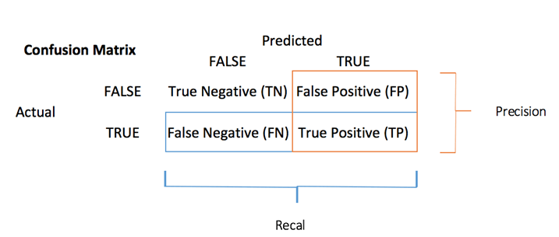
outcomes of the confusion matrix
The confusion matrix visualizes the accuracy of a classifier by comparing the actual and predicted classes. The binary confusion matrix is composed of squares:

Slide 4
True negatives: correctly predicted negatives (zeros)
True positives: correctly predicted positives (ones)
False negatives: incorrectly predicted negatives (zeros)
False positives: incorrectly predicted positives (ones)

Slide 5
TP(True Positive): Predicted values correctly predicted as actual positive
FP(False Positive): Predicted values incorrectly predicted an actual positive. i.e., Negative values predicted as positive
FN(False Negative): Positive values predicted as negative
TN(True Negative): Predicted values correctly predicted as an actual negative

Slide 6
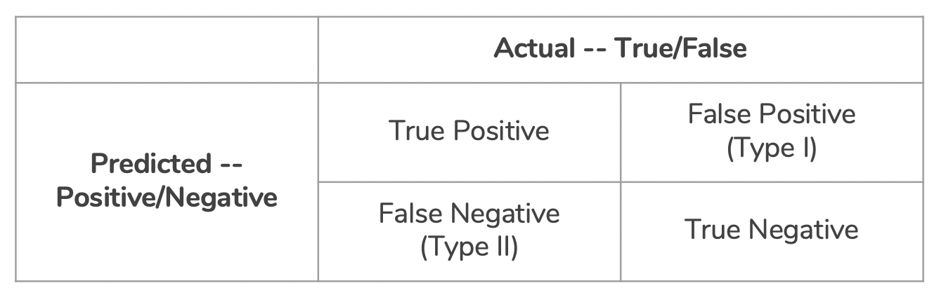
Types of Errors

Slide 7

Accuracy
You can compute the accuracy test from the confusion matrix:

Slide 8

Precision
The precision metric shows the accuracy of the positive class. It measures how likely the prediction of the positive class is correct.
How much were correctly classified as positive out of all positives. Precision = TP/TP+FP
Precision (true positives / predicted positives) = TP / TP + FP

Slide 9

Recall or Sensitivity
Sensitivity of a classifier is the ratio between how much were correctly identified as positive to how much were actually positive.
Sensitivity = TP / FN+TP
Where it is used ? Places where classification of positives are high priority. Eg: Security checks in airports.

Slide 10
Where does precision and recall are used ?
The harmonic mean of precision and recall gives a score call f1 score which is a measure of performance of the model’s classification ability.
F1 score = 2 * (precision * recall)/ (precision + recall)
F1 score is considered a better indicator of the classifier’s performance than the regular accuracy measure.

Slide 11
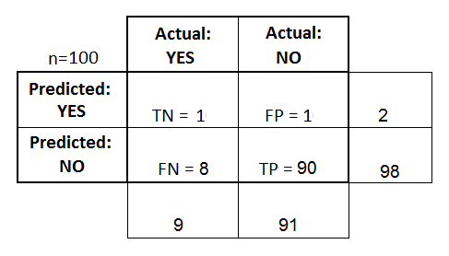
Eg confusion matrix
Accuracy: (TP+TN)/total = (1+90)/100 = 91%
Precision: TP/predicted yes = 1/2 = 50%
Recall: TP/Actual yes = 1/9 = 11%

Slide 12


F Score:
F1 score is a weighted average score of the true positive (recall) and precision.
When Beta is equal to 1, we have the harmonic mean, and for this particular value of Beta, we say that this is the F1 Score:

Slide 13
What is AUC - ROC Curve?
AUC - ROC curve is a performance measurement for classification problem at various thresholds settings. ROC is a probability curve and AUC represents degree or measure of separability. It tells how much model is capable of distinguishing between classes. Higher the AUC, better the model is at predicting 0s as 0s and 1s as 1s. By analogy, Higher the AUC, better the model is at distinguishing between patients with disease and no disease.
The ROC curve is plotted with TPR against the FPR where TPR is on y-axis and FPR is on the x-axis.

Slide 14
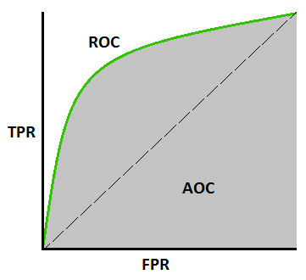

Slide 15

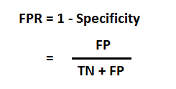

TPR (True Positive Rate)
FPR
Specificity

Slide 16
Eg: AUROC
Threshold: 0,0.2,0.4,0.6,0.8. 1
TN = 1 to 1, FN = 1 to 0, FP = 0 to 1, TN = 0 to 0
Y | Y pred | T 0 | T .2
1 | 0.8 | 1 | 1
0 | 0.96 | 1 | 1
1 | 0.4 | 1 | 1
1 | 0.3 | 1 | 1
0 | 0.2 | 1 | 0
1 | 0.7 | 1 | 1

